Slide 1
Business Analytics
Unit 02 – Descriptive Statistics

Slide 2
Overview of Using Data: Definitions and Goals
Data are the facts and figures collected, analyzed, and summarized for presentation and interpretation.
A variable is a characteristic or a quantity of interest that can take on different values.
An observation is a set of values corresponding to a set of variables.
Variation is the difference in a variable measured over observations.
The role of descriptive analytics is to collect and analyze data to better understand variation and its impact on the business setting.
A random variable, or uncertain variable, is a quantity whose values are not known with certainty.

Slide 3
Types of Data
A sample is a subset of the population, which consists of all the elements of interest.
Random sampling is a sampling method that allows gathering a representative sample from the population data.
Data are considered quantitative data if numeric and arithmetic operations, such as addition, subtraction, multiplication, and division, can be performed.
If arithmetic operations cannot be performed, they are categorical data.
Cross-sectional data are data collected from several entities at the same, or approximately the same, point in time.
Time series data are data collected over several time periods.

Slide 4
Sources of Data
Data necessary to analyze a business problem can often be obtained with a statistical study.
Statistical studies can be classified as experimental or observational.
In an experimental study, a variable of interest is first identified.
Then, one or more other variables are identified and controlled or manipulated to obtain data about how they influence the variable of interest.
A nonexperimental or observational study does not attempt to control the variables of interest.
A survey is perhaps the most common type of observational study.

Slide 5
Frequency Distributions for Categorical Data
A frequency distribution summarizes data showing the number (frequency) of observations in several nonoverlapping classes, typically referred to as bins.
Soft Drink | Frequency
Coca-Cola | 18
Diet Coke | 8
Dr. Pepper | 5
Pepsi | 14
Sprite | 5
Total | 50
Notes:
To develop a frequency distribution of soft drinks:
The sample data are shown in cell range A2:B26.
Column D contains the five different soft drink categories as the bins.
In cell E2, enter the formula =COUNTIF($A$2:$B$26, D2), where A2:B26 is the range for the sample data, and D2 is the bin (Coca-Cola) to match.
The COUNTIF function in Excel counts the number of times a certain value appears in the indicated range.
In this case, we want to count the number of times Coca-Cola appears in the sample data. The result is a value of 19 in cell E2, indicating that Coca-Cola appears 19 times in the sample data.
The formula from cell E2 can be copied to cells E3 to E6 to get frequency counts for Diet Coke, Pepsi, Dr. Pepper, and Sprite.
By using the absolute reference $A$2:$B$26 in the formula, Excel always searches the same sample data for the values we want when we copy the formula.

Slide 6
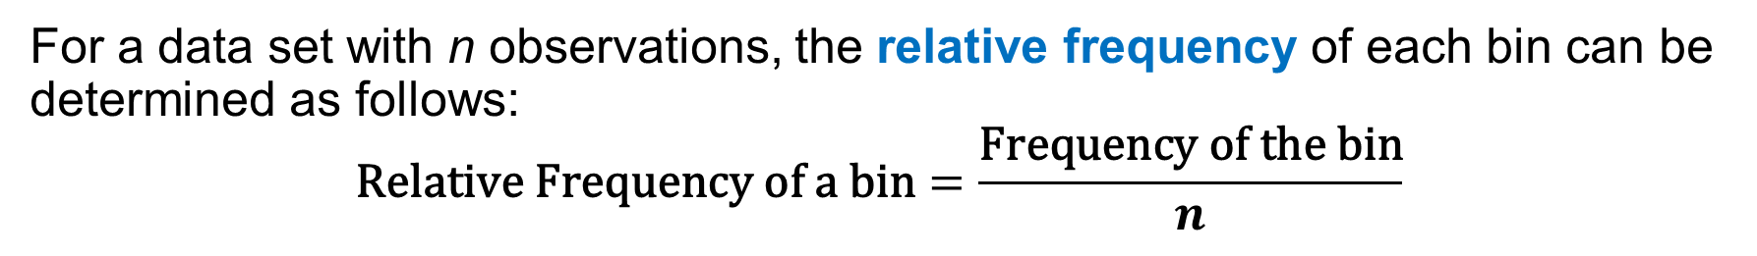
Relative Frequency and Percent Frequency Distributions
For a data set with n observations, the relative frequency of each bin can be determined as follows:
$$\text{Relative} \text{Frequency} \text{of} \text{a} \text{bin}=\frac{\text{Frequency} \text{of} \text{the} \text{bin}}{n}$$
A relative frequency distribution is a tabular summary of data showing the relative frequency for each bin.
A percent frequency distribution summarizes the percent frequency of the data for each bin.
It can be used to provide estimates of the relative likelihoods of different values of a random variable.
Soft Drink | Relative Frequency | Percent Frequency (%)
Coca-Cola | 0.36 | 36
Diet Coke | 0.16 | 16
Dr. Pepper | 0.10 | 10
Pepsi | 0.28 | 28
Sprite | 0.10 | 10
Total | 1.00 | 100

Slide 7
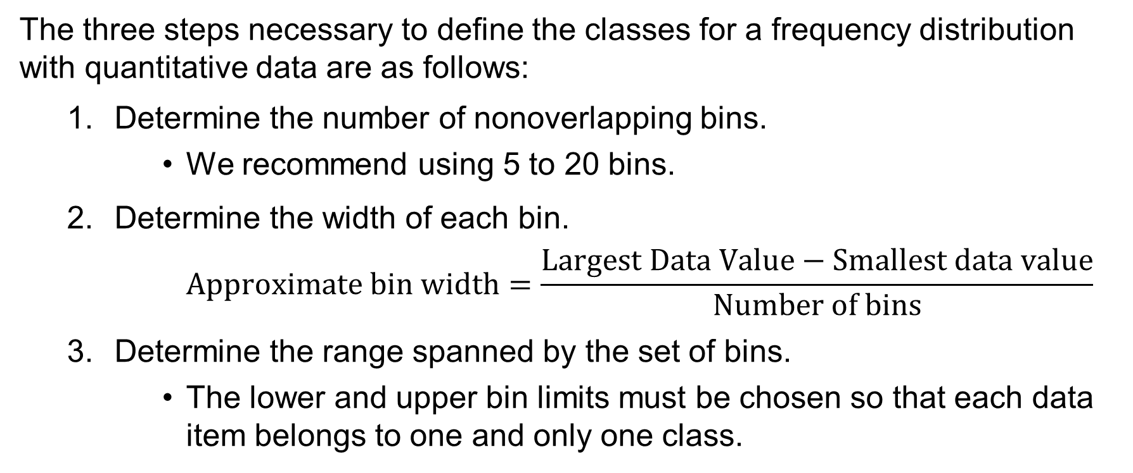
Frequency Distributions for Quantitative Data
The three steps necessary to define the classes for a frequency distribution with quantitative data are as follows:
Determine the number of nonoverlapping bins.
We recommend using 5 to 20 bins.
Determine the width of each bin.
$$\text{Approximate} \text{bin} \text{width}=\frac{\text{Largest} \text{Data} \text{Value}−\text{Smallest} \text{data} \text{value}}{\text{Number} \text{of} \text{bins}}$$
Determine the range spanned by the set of bins.
The lower and upper bin limits must be chosen so that each data item belongs to one and only one class.

Slide 8
Histograms
A Histogram is a common graphical presentation of quantitative data.
A histogram is constructed by placing the variable of interest on the horizontal axis and the selected frequency measure (absolute frequency, relative frequency, or percent frequency) on the vertical axis.
The frequency measure of each class is shown by drawing a rectangle whose base is the class limits on the horizontal axis and whose height is the corresponding frequency measure.
A histogram is a column chart with no spaces between the columns whose heights represent the frequencies of the corresponding bins.
Eliminating the space between the columns allows a histogram to reflect the continuous nature of the variable of interest.

Slide 9
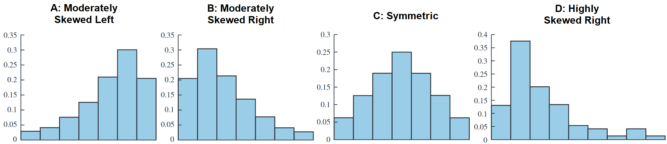
Histograms Showing Differing Levels of Skewness
Histograms provide information about the shape, or form, of a distribution.
Skewness, or lack of symmetry, is an important characteristic of the shape of a distribution.
The four histograms shown below are constructed from relative frequency distributions that exhibit different patterns of skewness.

Slide 10
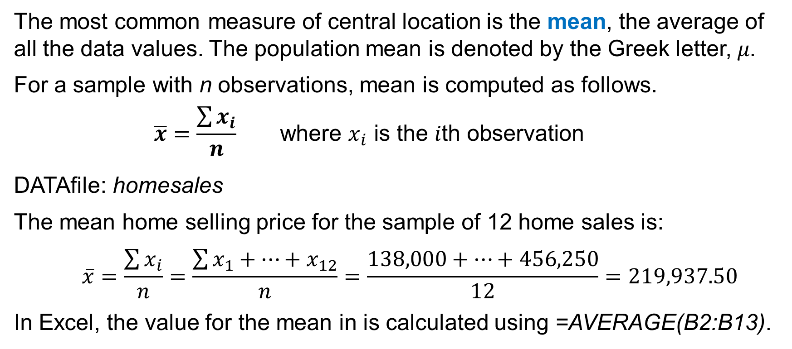
Mean
The most common measure of central location is the mean, the average of all the data values. The population mean is denoted by the Greek letter, 𝜇.
For a sample with n observations, mean is computed as follows.
$$\overline{x}=\frac{\sum{x_{i}}}{n} \text{where} x_{i} \text{is} \text{the} i\text{th} \text{observation}$$
DATAfile: homesales
The mean home selling price for the sample of 12 home sales is:
$$\overline{x}=\frac{\sum{x_{i}}}{n}=\frac{\sum{x_{1}+…+x_{12}}}{n}=\frac{138,000+…+456,250}{12}=219,937.50$$
In Excel, the value for the mean in is calculated using =AVERAGE(B2:B13).

Slide 11
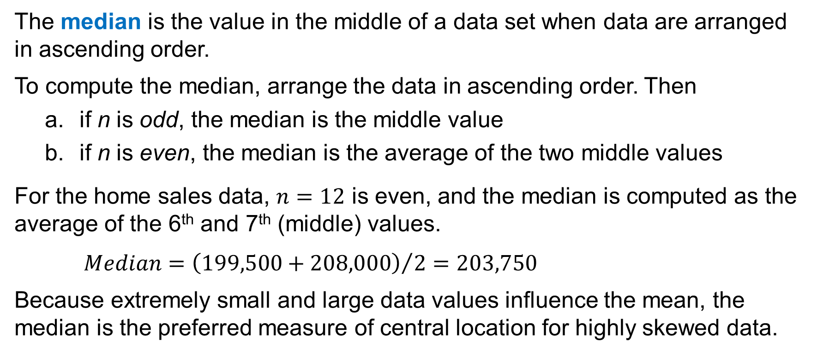
Median
The median is the value in the middle of a data set when data are arranged in ascending order.
To compute the median, arrange the data in ascending order. Then
if n is odd, the median is the middle value
if n is even, the median is the average of the two middle values
For the home sales data, $n=12$ is even, and the median is computed as the average of the 6th and 7th (middle) values.
$$Median={\left(199,500+208,000\right)}/2=203,750$$
Because extremely small and large data values influence the mean, the median is the preferred measure of central location for highly skewed data.

Slide 12
Mode
The mode of a data set is the value that occurs with the greatest frequency.
In Excel, we can find the mode using the MODE.SNGL function.
The greatest frequency may occur at two or more different values. In these instances, more than one mode exists.
If the data have exactly two modes, the data are said to be bimodal.
If the data have more than two modes, the data are said to be multimodal.
In Excel, we can find multiple modes using the MODE.MULT function.
For the home sales data, =MODE.MULT(B2:B13) returns two modes.

Slide 13
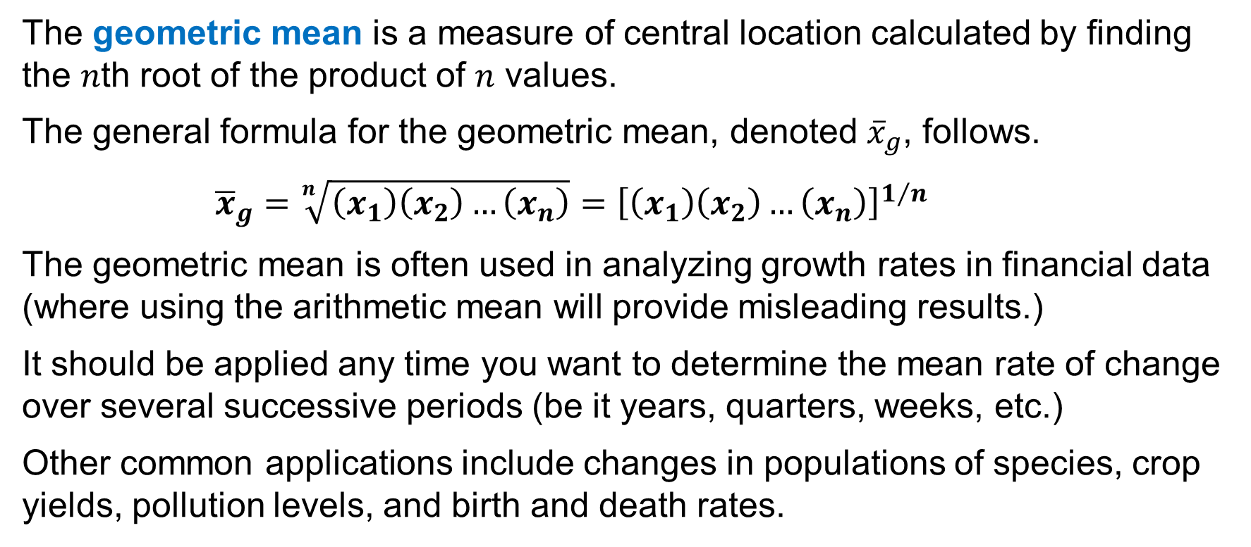
Geometric Mean
The geometric mean is a measure of central location calculated by finding the 𝑛th root of the product of 𝑛 values.
The general formula for the geometric mean, denoted ${\overline{x}}_{g}$, follows.
$${\overline{x}}_{g}=\sqrt[n]{\left(x_{1}\right)\left(x_{2}\right)…\left(x_{n}\right)}={\left[\left(x_{1}\right)\left(x_{2}\right)…\left(x_{n}\right)\right]}^{1/n}$$
The geometric mean is often used in analyzing growth rates in financial data (where using the arithmetic mean will provide misleading results.)
It should be applied any time you want to determine the mean rate of change over several successive periods (be it years, quarters, weeks, etc.)
Other common applications include changes in populations of species, crop yields, pollution levels, and birth and death rates.

Slide 14
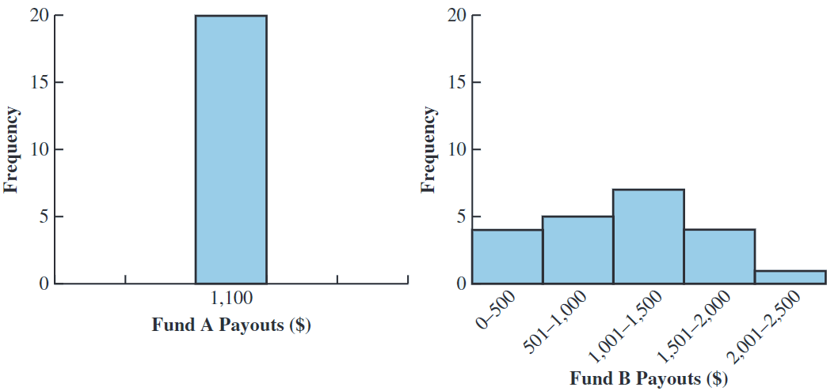
Measures of Variability
It is often desirable to consider measures of variability, or dispersion).
Consider the annual payouts for two different investment funds, A and B.
Although the mean payout is the same for the two funds, their histograms differ because the payouts associated with Fund B have greater variability.
In this section, we present several ways to measure variability.

Slide 15
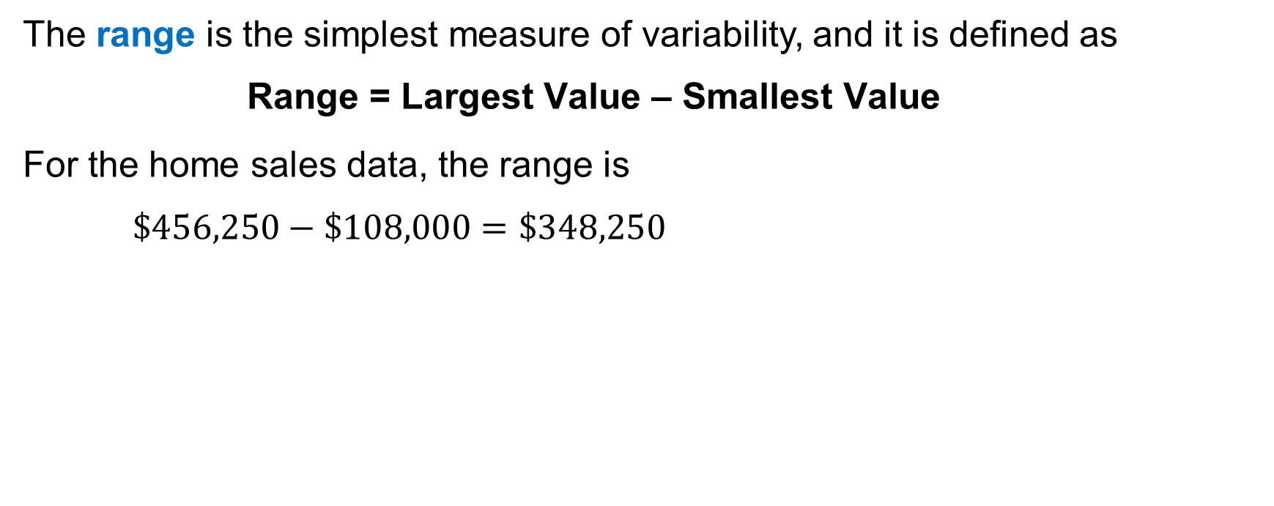
Range
The range is the simplest measure of variability, and it is defined as
$$\text{Range}\text{ = }\text{Largest} \text{Value}\text{ – }\text{Smallest} \text{Value}$$
For the home sales data, the range is
$$\$456,250−\$108,000=\$348,250$$

Slide 16
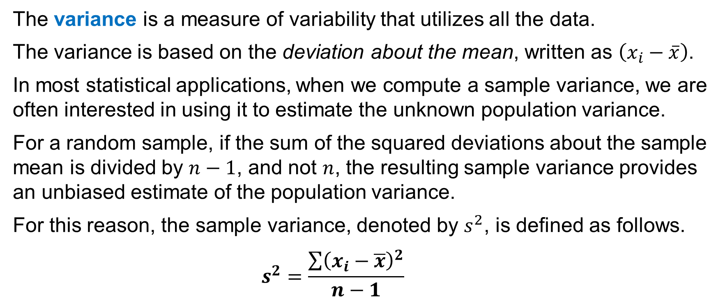
Variance
The variance is a measure of variability that utilizes all the data.
The variance is based on the deviation about the mean, written as $\left(x_{i}−\overline{x}\right)$.
In most statistical applications, when we compute a sample variance, we are often interested in using it to estimate the unknown population variance.
For a random sample, if the sum of the squared deviations about the sample mean is divided by $n−1$, and not $n$, the resulting sample variance provides an unbiased estimate of the population variance.
For this reason, the sample variance, denoted by $s^{2}$, is defined as follows.
$$s^{2}=\frac{\sum{{\left(x_{i}−\overline{x}\right)}^{2}}}{n−1}$$

Slide 17
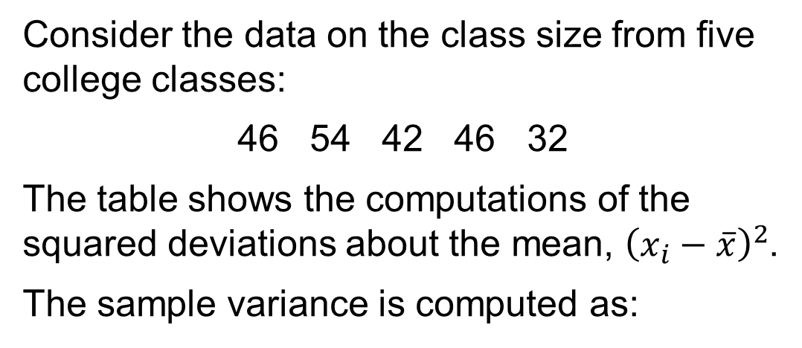
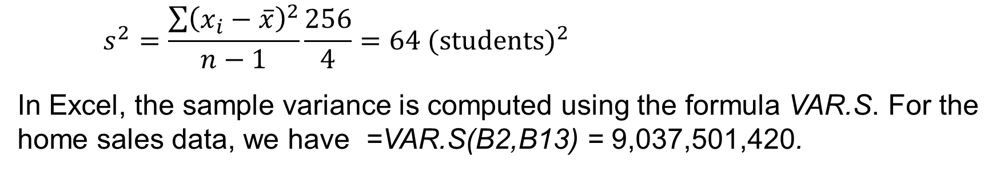
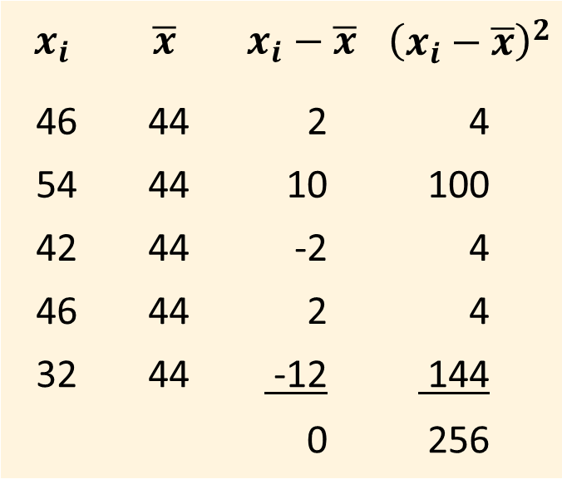
Computation of the Variance
Consider the data on the class size from five college classes:
46 54 42 46 32
The table shows the computations of the squared deviations about the mean, ${\left(x_{i}−\overline{x}\right)}^{2}$.
The sample variance is computed as:
$$x_{i}$$ | $$\overline{x}$$ | $$x_{i}−\overline{x}$$ | $${\left(x_{i}−\overline{x}\right)}^{2}$$
46 | 44 | 2 | 4
54 | 44 | 10 | 100
42 | 44 | -2 | 4
46 | 44 | 2 | 4
32 | 44 | -12 | 144
 |  | 0 | 256
$$s^{2}=\frac{\sum{{\left(x_{i}−\overline{x}\right)}^{2}}}{n−1}\frac{256}{4}=64 {(\text{students})}^{2}$$
In Excel, the sample variance is computed using the formula VAR.S. For the home sales data, we have =VAR.S(B2,B13) = 9,037,501,420.

Slide 18
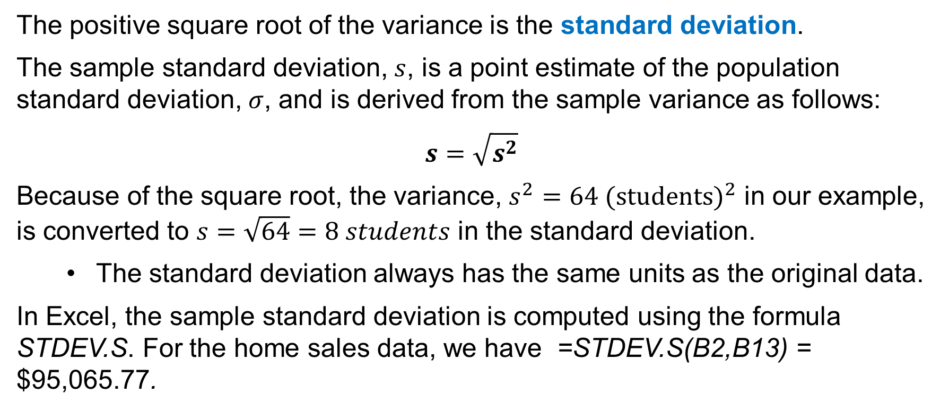
Standard Deviation
The positive square root of the variance is the standard deviation.
The sample standard deviation, $s$, is a point estimate of the population standard deviation, $σ$, and is derived from the sample variance as follows:
$$s=\sqrt{s^{2}}$$
Because of the square root, the variance, ${s^{2}=64 (\text{students})}^{2}$ in our example, is converted to $s=\sqrt{64}=8 students$ in the standard deviation.
The standard deviation always has the same units as the original data.
In Excel, the sample standard deviation is computed using the formula STDEV.S. For the home sales data, we have =STDEV.S(B2,B13) = $95,065.77.

Slide 19
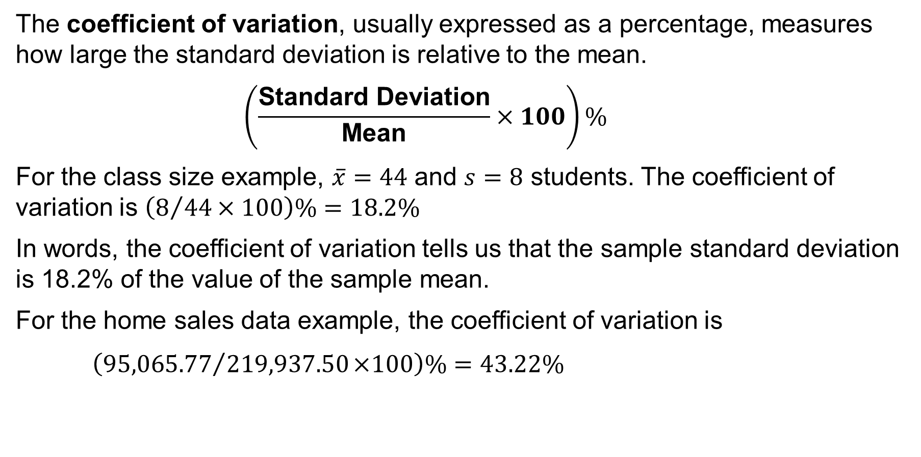
Coefficient of Variation
The coefficient of variation, usually expressed as a percentage, measures how large the standard deviation is relative to the mean.
$$\left(\frac{\text{Standard} \text{Deviation}}{\text{Mean}}×100\right)\%$$
For the class size example, $\overline{x}=44$ and $s=8$ students. The coefficient of variation is $\left(8/{44}×100\right)\%=18.2\%$
In words, the coefficient of variation tells us that the sample standard deviation is 18.2% of the value of the sample mean.
For the home sales data example, the coefficient of variation is
$$\left({95,065.77}/{\text{219,937.50}}\text{×}\text{100}\right)\text{\%}=43.22\%$$

Slide 20
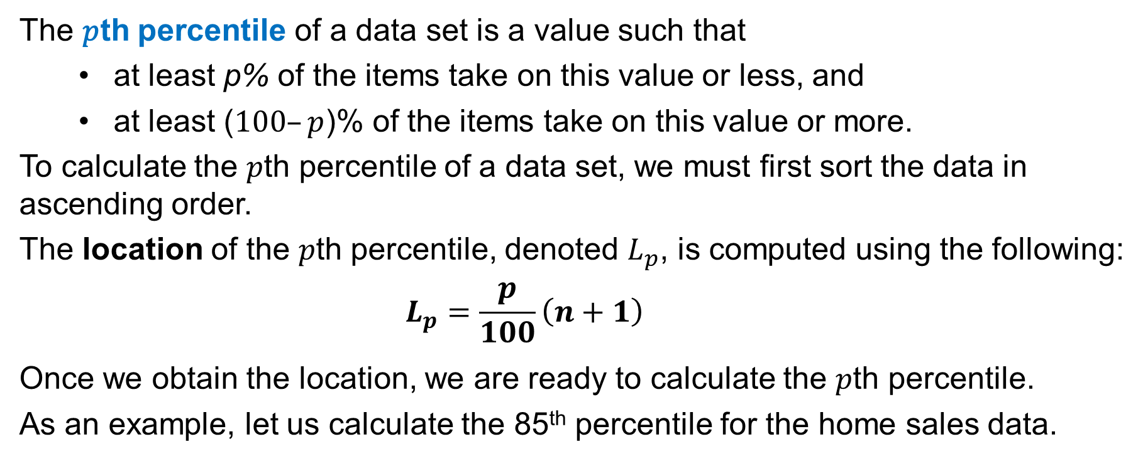
Percentiles
The 𝑝th percentile of a data set is a value such that
at least p% of the items take on this value or less, and
at least ($100–p$)% of the items take on this value or more.
To calculate the 𝑝th percentile of a data set, we must first sort the data in ascending order.
The location of the 𝑝th percentile, denoted $L_{p}$, is computed using the following:
$$L_{p}=\frac{p}{100}\left(n+1\right)$$
Once we obtain the location, we are ready to calculate the 𝑝th percentile.
As an example, let us calculate the 85th percentile for the home sales data.

Slide 21
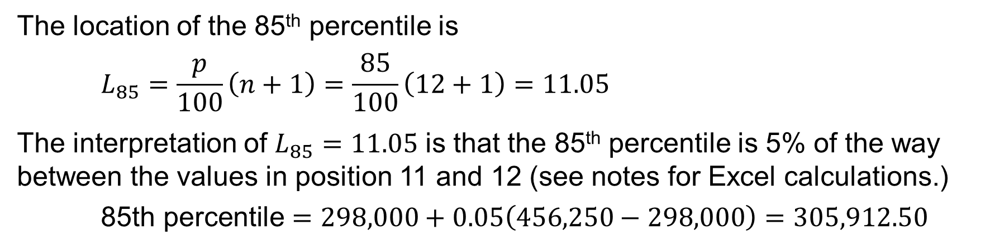
An Application of the Percentile
With the home sales data arranged in ascending order, we indicate the position of each observation directly below its value.
Price | 108,000 | 138,000 | 138,000 | 142,000 | 186,000 | 199,500 | 208,000 | 254,000 | 254,000 | 257,500 | 298,000 | 456,250
Position | 1 | 2 | 3 | 4 | 5 | 6 | 7 | 8 | 9 | 10 | 11 | 12
The location of the 85th percentile is
$$L_{85}=\frac{p}{100}\left(n+1\right)=\frac{85}{100}\left(12+1\right)=11.05$$
The interpretation of $L_{85}=11.05$ is that the 85th percentile is 5% of the way between the values in position 11 and 12 (see notes for Excel calculations.)
$$\text{85}\text{th} \text{percentile}=298,000+0.05\left(456,250−298,000\right)=305,912.50$$
Notes:
To calculate the 86th percentile for the home sales data in Excel, we use the formula =PERCENTILE.EXC(B2:B13,0.85) = 305,912.50. Remember that you do not have to sort the data to use the Excel percentile formula.

Slide 22
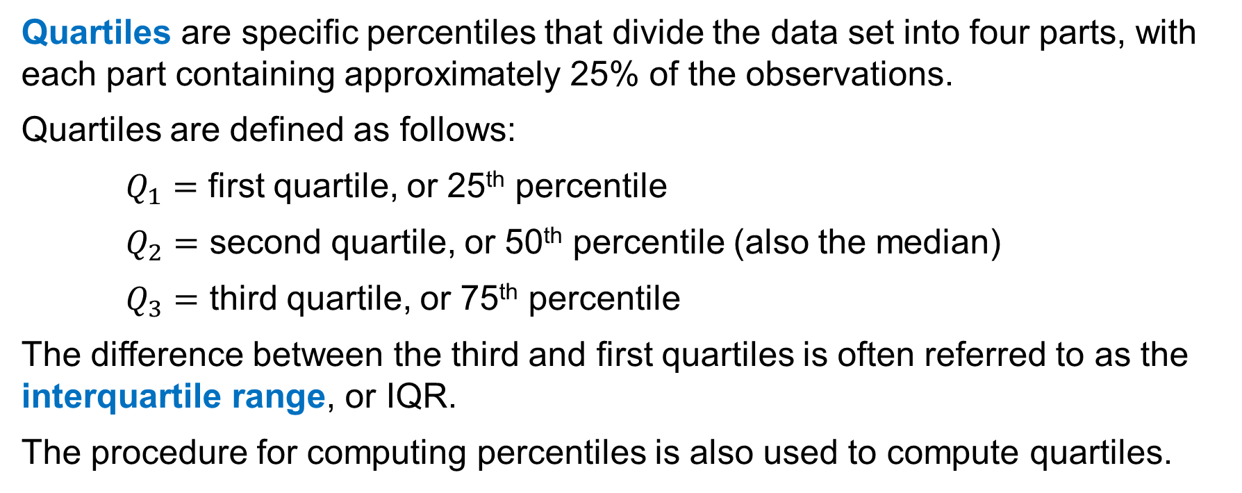
Quartiles
Quartiles are specific percentiles that divide the data set into four parts, with each part containing approximately 25% of the observations.
Quartiles are defined as follows:
$Q_{1}=$ first quartile, or 25th percentile
$Q_{2}=$ second quartile, or 50th percentile (also the median)
$Q_{3}=$ third quartile, or 75th percentile
The difference between the third and first quartiles is often referred to as the interquartile range, or IQR.
The procedure for computing percentiles is also used to compute quartiles.

Slide 23
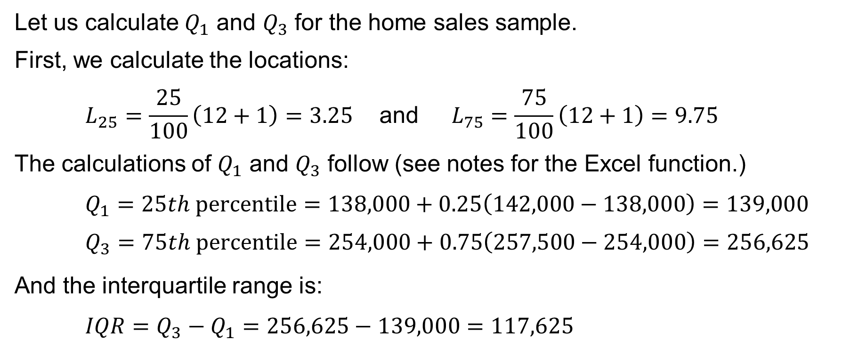
An Application of Quartiles
Let us calculate $Q_{1}$ and $Q_{3}$ for the home sales sample.
First, we calculate the locations:
$$L_{25}=\frac{25}{100}\left(12+1\right)=3.25 \text{and} L_{75}=\frac{75}{100}\left(12+1\right)=9.75$$
The calculations of $Q_{1}$ and $Q_{3}$ follow (see notes for the Excel function.)
$$Q_{1}=25th \text{percentile}=138,000+0.25\left(142,000−138,000\right)=139,000$$
$Q_{3}=75th \text{percentile}=254,000+0.75\left(257,500−254,000\right)=256,625$
And the interquartile range is:
$$IQR=Q_{3}−Q_{1}=256,625−139,000=117,625$$
Notes:
A quartile can be computed in Excel using the function QUARTILE.EXC:
$Q_{1}=$ QUARTILE.EXC(B2:B13,1)
$Q_{3}=$ QUARTILE.EXC(B2:B13,3)

Slide 24
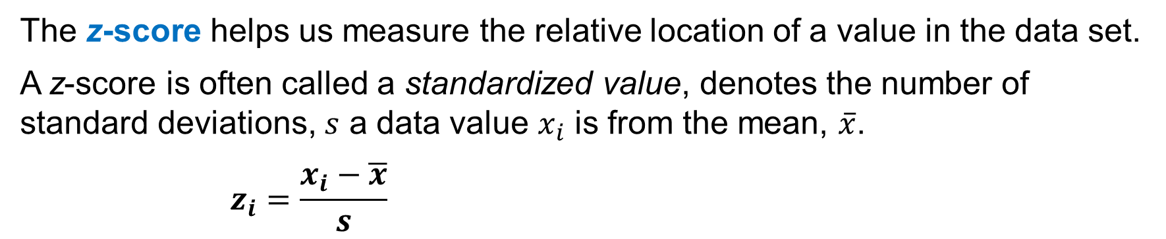
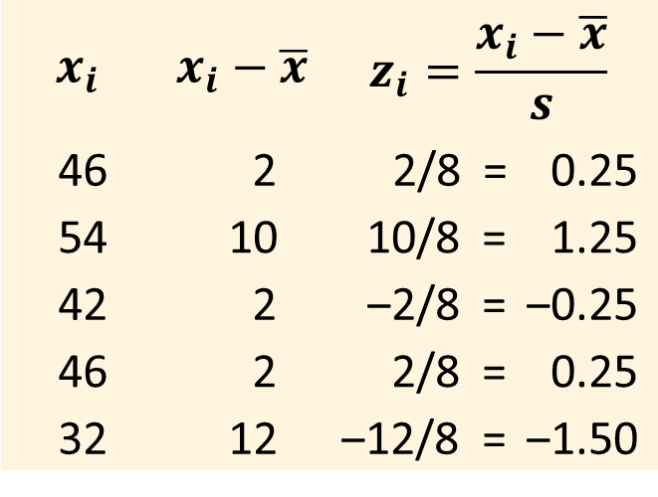
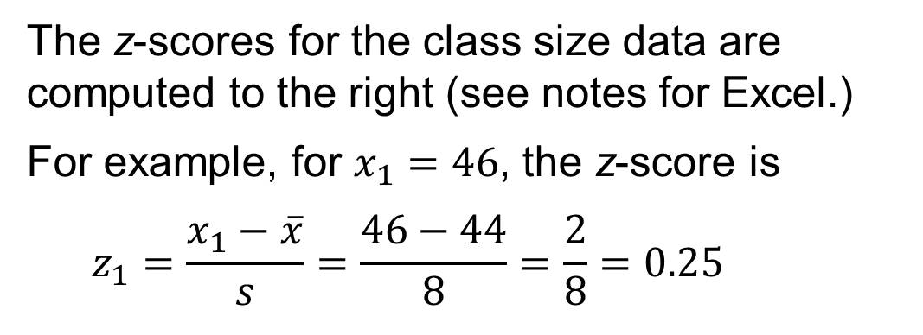
z-Scores
The z-score helps us measure the relative location of a value in the data set.
A z-score is often called a standardized value, denotes the number of standard deviations, $s$ a data value $x_{i}$ is from the mean, $\overline{x}$.
$$z_{i}=\frac{x_{i}−\overline{x}}{s}$$
$$x_{i}$$ | $$x_{i}−\overline{x}$$ | $$z_{i}=\frac{x_{i}−\overline{x}}{s}$$
46 | 2 | 2/8 = 0.25
54 | 10 | 10/8 = 1.25
42 | 2 | ‒2/8 = ‒0.25
46 | 2 | 2/8 = 0.25
32 | 12 | ‒12/8 = ‒1.50
The z-scores for the class size data are computed to the right (see notes for Excel.)
For example, for $x_{1}=46$, the z-score is
$$z_{1}=\frac{x_{1}−\overline{x}}{s}=\frac{46−44}{8}=\frac{2}{8}=0.25$$
Notes:
The z-scores can be calculated in Excel using the function =STANDARDIZE($x_{i}$,$\overline{x}$,$s$).
For example, $z_{1}$=STANDARDIZE(46,44,8) = 0.25.

Slide 25
Empirical Rule
When the data are believed to approximate a symmetric bell-shaped distribution, the empirical rule can be used to determine the percentage of data values within a specified number of standard deviations of the mean.
For data having a bell-shaped distribution:
~68% of the data values will be within one standard deviation of the mean.
~95% of the data values will be within two standard deviations of the mean.
Almost all data values will be within three standard deviations of the mean.
If the height of adult males in the U.S. follows a bell-shaped distribution, with a mean of 69.5 inches and a standard deviation of 3 inches:
~95% of U.S. adult males will have heights between 63.5 and 75.5 inches.

Slide 26
Identifying Outliers
An outlier is an unusually small or unusually large value in a data set.
Care should be taken when handling outliers, as they might be:
an incorrectly recorded data value
a data value that was incorrectly included in the data set
a correctly recorded data value that belongs in the data set
Standardized values (z-scores) can be used to identify potential outliers.
A data value with a z-score less than –3 or greater than +3 might be a candidate for being an outlier (see notes for details.)
Such data values can then be reviewed to determine their accuracy and whether they belong in the data set.
Notes:
There are two definitions for what constitutes an outlier.
We use the three standardized values rule for symmetric and bell-shaped distributions.
As shown in the next slide, we use the limits defined by quartiles in box plots for skewed distributions.

Slide 27
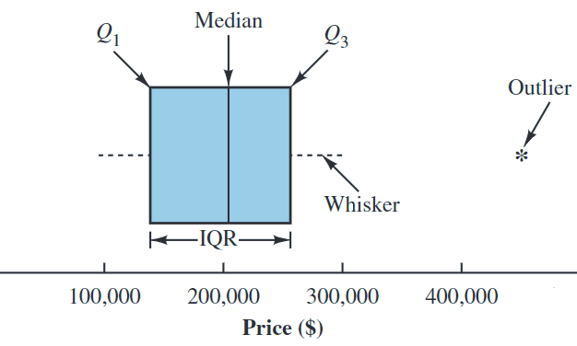
Boxplots
A boxplot, also known as box-and-whisker plot, is a graphical summary of the distribution of data developed from the quartiles for a data set.
Shown to the right is the boxplot for the home sales data containing a single outlier.
See notes for the steps needed to create a boxplot in Excel.
Notes:
Steps used to construct the boxplot for the home sales data:
Step 1. A box is drawn with the ends of the box located at the first and third quartiles. For the home sales data, Q1 = 139,000 and Q3 = 256,625. This box contains the middle 50% of the data.
Step 2. A vertical line is drawn in the box at the location of the median (203,750 for the home sales data).
Step 3. By using the interquartile range, IQR = Q₃ – Q₁, limits are located. The limits for the boxplot are 1.5(IQR) below Q1 and 1.5(IQR) above Q3. For the home sales data, IQR = Q₃ – Q₁ = 256,625 – 139,000 = 117,625. Thus, the limits are 139,000 – 1.5(117,625) = –37,437.5 and 256,625 + 1.5(117,625) = 433,062.5. Data outside these limits are considered outliers.
Step 4. The dashed lines are called whiskers. The whiskers are drawn from the ends of the box to the smallest and largest values inside the limits computed in Step 3. Thus, the whiskers end at home sales values of 108,000 and 298,000.
Step 5. Finally, the location of each outlier is shown with an asterisk (*). In the boxplot, we see one outlier, 456,250.

Slide 28
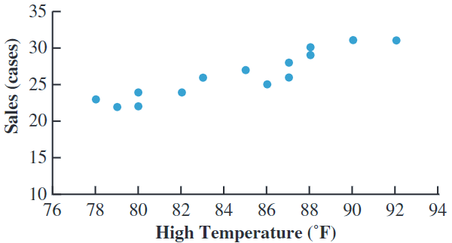
Scatter Charts
A scatter chart is a graph for analyzing the relationship between two variables.
The scatter chart for the bottled water sales at Queensland Amusement Park over 14 summer days suggests a
positive and linear relationship
between high temperature and bottled water sales.

Slide 29
Covariance
Covariance is a descriptive measure of the linear association between two variables.
For a sample of size $n$ with observations ($x_{i},y_{i}$), the sample covariance is:
$$s_{xy}=\frac{\sum{\left(x_{i}−\overline{x}\right)\left(y_{i}−\overline{y}\right)}}{n−1}$$
For the bottled water data, we can calculate the sample covariance between high temperatures and sales using Excel as:
$s_{xy}=$COVARIANCE.S(A2:A15,B2:B15) = 12.80
The positive covariance indicates a positive relationship between the variables.
See notes for the definition of the covariance of population data.
Notes:
If the data consists of a population of size N, the population covariance is defined as.
$$σ_{xy}=\frac{\sum{\left(x_{i}−\overline{x}\right)\left(y_{i}−\overline{y}\right)}}{N}$$

Slide 30
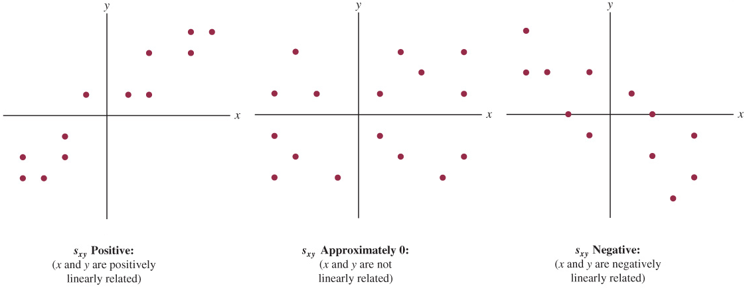
Relationship Between Pattern and Covariance

Slide 31
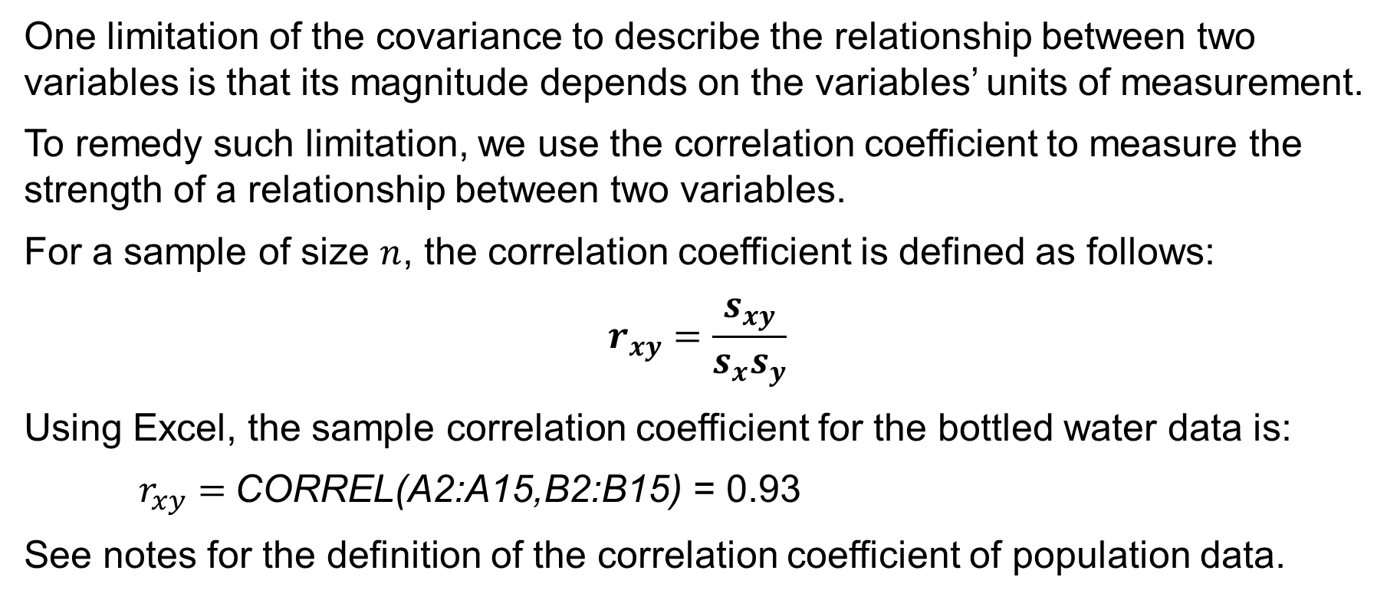
Correlation Coefficient
One limitation of the covariance to describe the relationship between two variables is that its magnitude depends on the variables’ units of measurement.
To remedy such limitation, we use the correlation coefficient to measure the strength of a relationship between two variables.
For a sample of size $n$, the correlation coefficient is defined as follows:
$$r_{xy}=\frac{s_{xy}}{s_{x}s_{y}}$$
Using Excel, the sample correlation coefficient for the bottled water data is:
$r_{xy}=$CORREL(A2:A15,B2:B15) = 0.93
See notes for the definition of the correlation coefficient of population data.
Notes:
If the data consists of a population of size N, the population correlation coefficient is defined as.
$$ρ_{xy}=\frac{σ_{xy}}{σ_{x}σ_{y}}$$

Slide 32
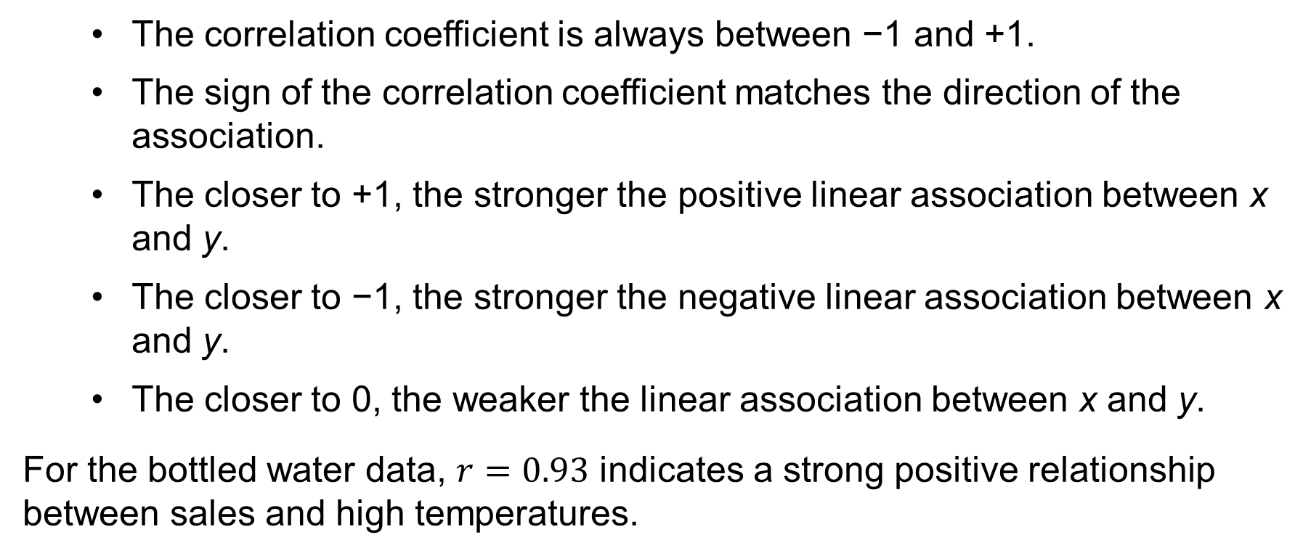
Interpretation of the Correlation Coefficient
The correlation coefficient is always between −1 and +1.
The sign of the correlation coefficient matches the direction of the association.
The closer to +1, the stronger the positive linear association between x and y.
The closer to −1, the stronger the negative linear association between x and y.
The closer to 0, the weaker the linear association between x and y.
For the bottled water data, $r=0.93$ indicates a strong positive relationship between sales and high temperatures.

Slide 33
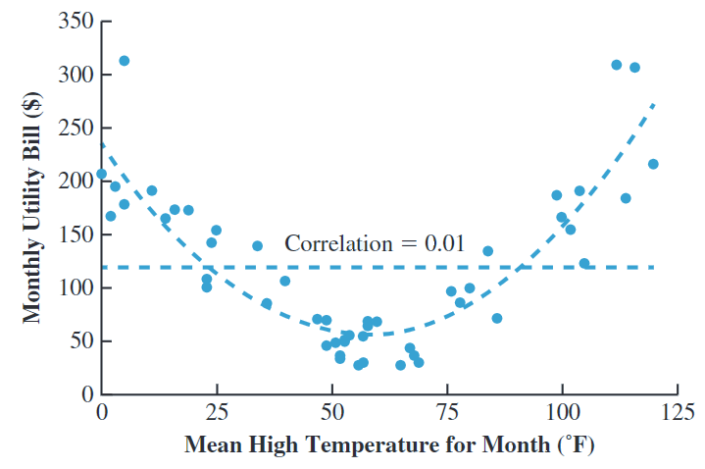
A Note on Linear Association
The correlation coefficient measures only the strength of the linear association
between two quantitative variables.
The sample correlation coefficient for the data shown here is $r_{xy}=0.01$ and indicates no linear relationship between the two variables, despite the strong visual evidence of a nonlinear relationship.

Slide 34
Summary
In this chapter, we have introduced descriptive statistics to summarize data.
We began by defining data types and data sources.
We presented several useful functions for modifying data in Excel.
We introduced the concept of a distribution and explained how to describe it using different interpretations of the frequency of counts and visualize it.
We then introduced measures of location, such as mean and median, and variability, such as variance and standard deviation.
We also presented additional measures for analyzing data distributions.
Finally, we discussed how to visualize the relationship between two variables and how to measure their linear association using covariance and correlation coefficient.

